Slide 1
ESE516 CLOUD STARTER
Eduardo Garcia
Spring 2022

Slide 2
MQTT Tools

Slide 3
Setting up a mqtt broker
Go to http://www.mqtt-dashboard.com/index.html
This is a public MQTT broker. You can find the parameters to join on the right. You do not need to do any action at this point – it is just informative!
MQTT connection settings
Host: broker.hivemq.com TCP Port: 1883 Websocket Port: 8000

Slide 4
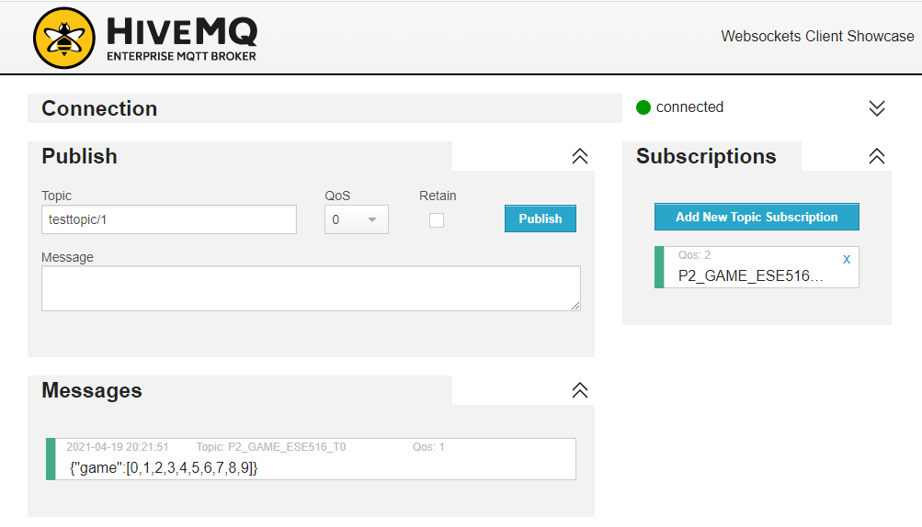
MQTT Client
http://www.hivemq.com/demos/websocket-client/
You can use this website client to connect to the MQTT server and publish/subscribe to topics. This can be really useful to determine that data is getting to the system.

Slide 5
SETUP – IBM NODE RED

Slide 6
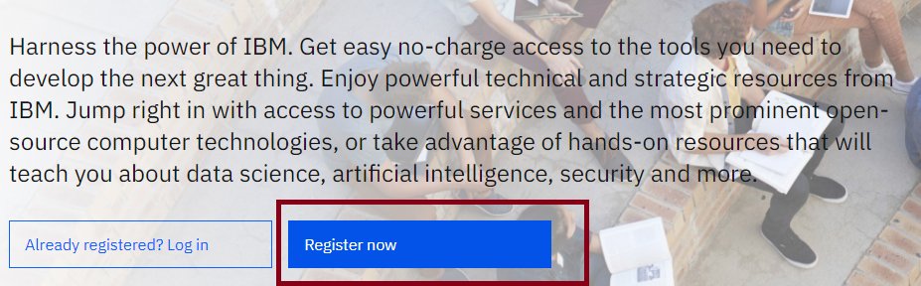
IBM CLOUD ACCOUNT
Go to ibm.com/academic and hit Register Now button

Slide 7
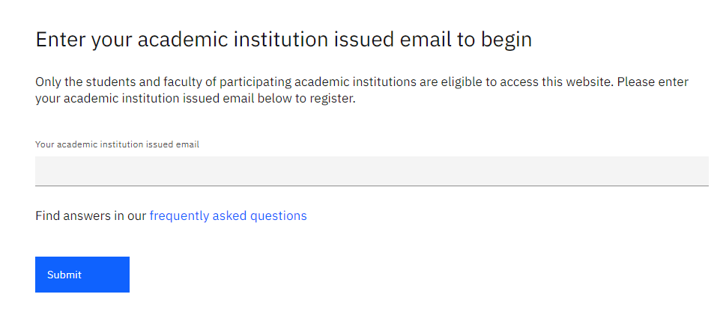
IBM CLOUD ACCOUNT
Enter your email and fill the information. You should register for an account

Slide 8
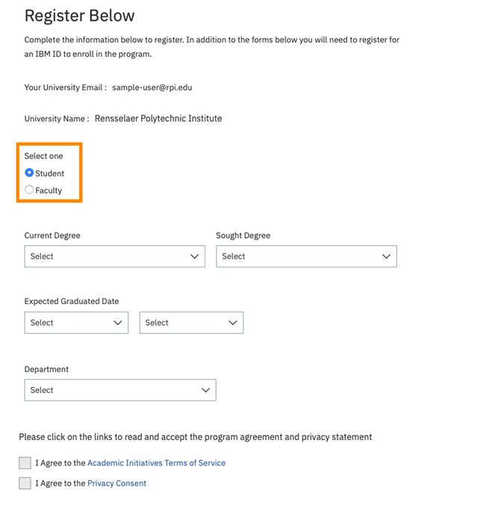
IBM CLOUD ACCOUNT
Enter your email and fill the information. You should register for an account.

Slide 9
IBM CLOUD ACCOUNT
Once you have an account, go back to www.ibm.com/academic

Slide 10
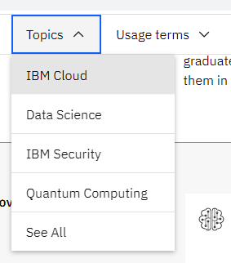
IBM CLOUD ACCOUNT
Go to Topics-> Cloud on the top toolbar of the webpage

Slide 11
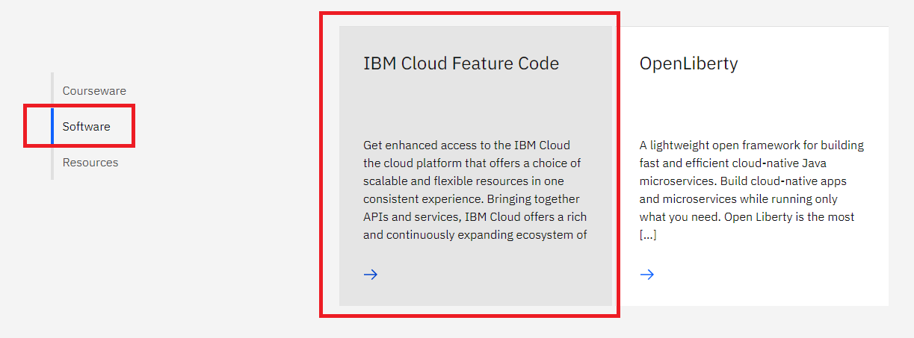
IBM CLOUD ACCOUNT
Scroll down until you get to the following. Select Software – IBM Cloud Feature Code

Slide 12
IBM CLOUD ACCOUNT
Scroll down until you get to the following. Select Software – IBM Cloud Feature Code

Slide 13
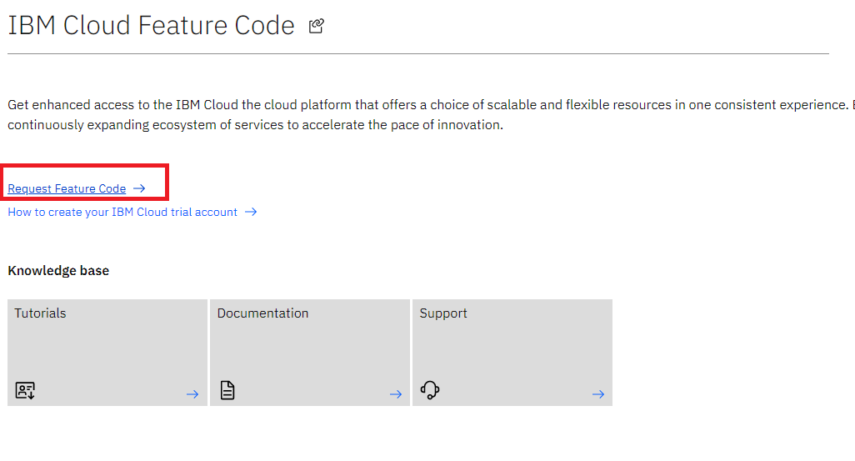
IBM CLOUD ACCOUNT
Click on Request Feature Code

Slide 14
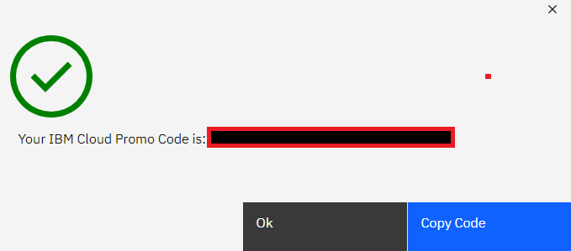
IBM CLOUD ACCOUNT
Copy the Promo Code.

Slide 15
IBM CLOUD ACCOUNT
Go to https://cloud.ibm.com/ and log in

Slide 16
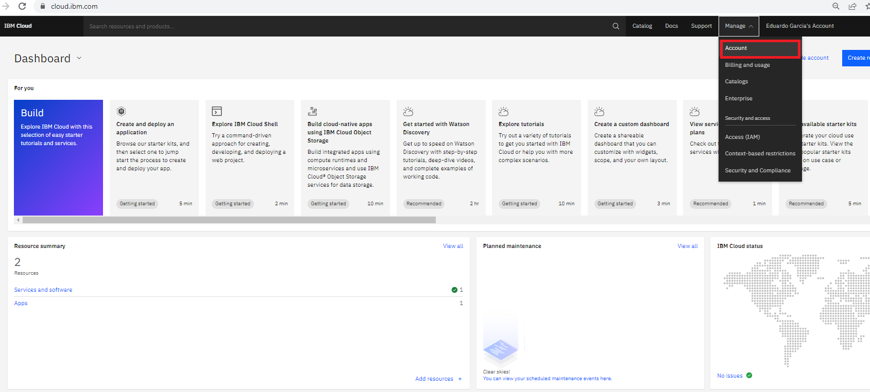
IBM CLOUD ACCOUNT
On the top right, select Manage -> Account

Slide 17
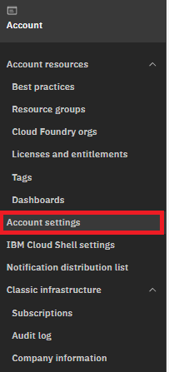
IBM CLOUD ACCOUNT
Select Account Settings on the left toolbar

Slide 18
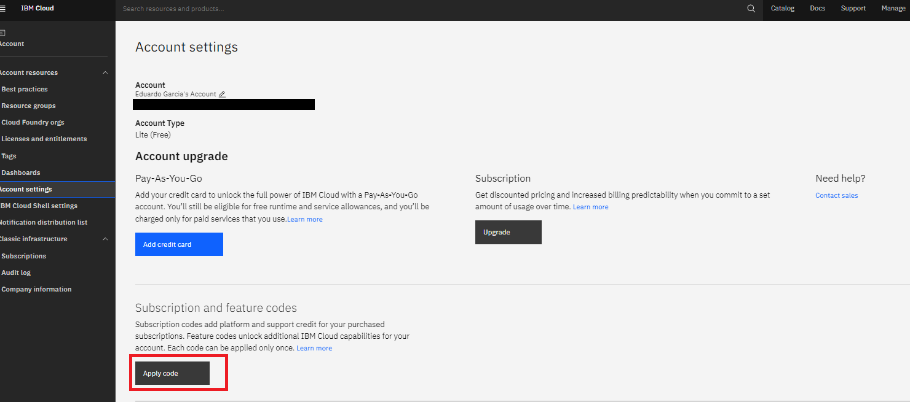
IBM CLOUD ACCOUNT
Select Apply code and type the code you copied before

Slide 19
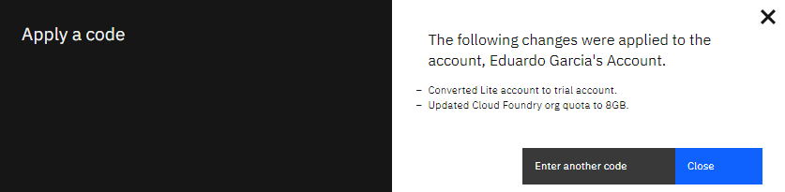
IBM CLOUD ACCOUNT
You should see a message like the following. NOTE: it might not be exactly the same as my account was made years ago (Lite Accounts do not exist anymore)

Slide 20
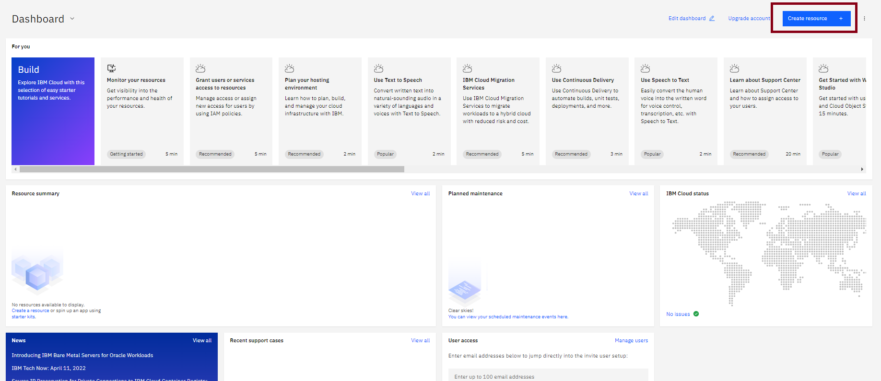
Add resource
Once you have your account ready, go back to the dashboard. You will be greeted with the IBM Cloud Dashboard. Click on the “Create” button on the top right

Slide 21
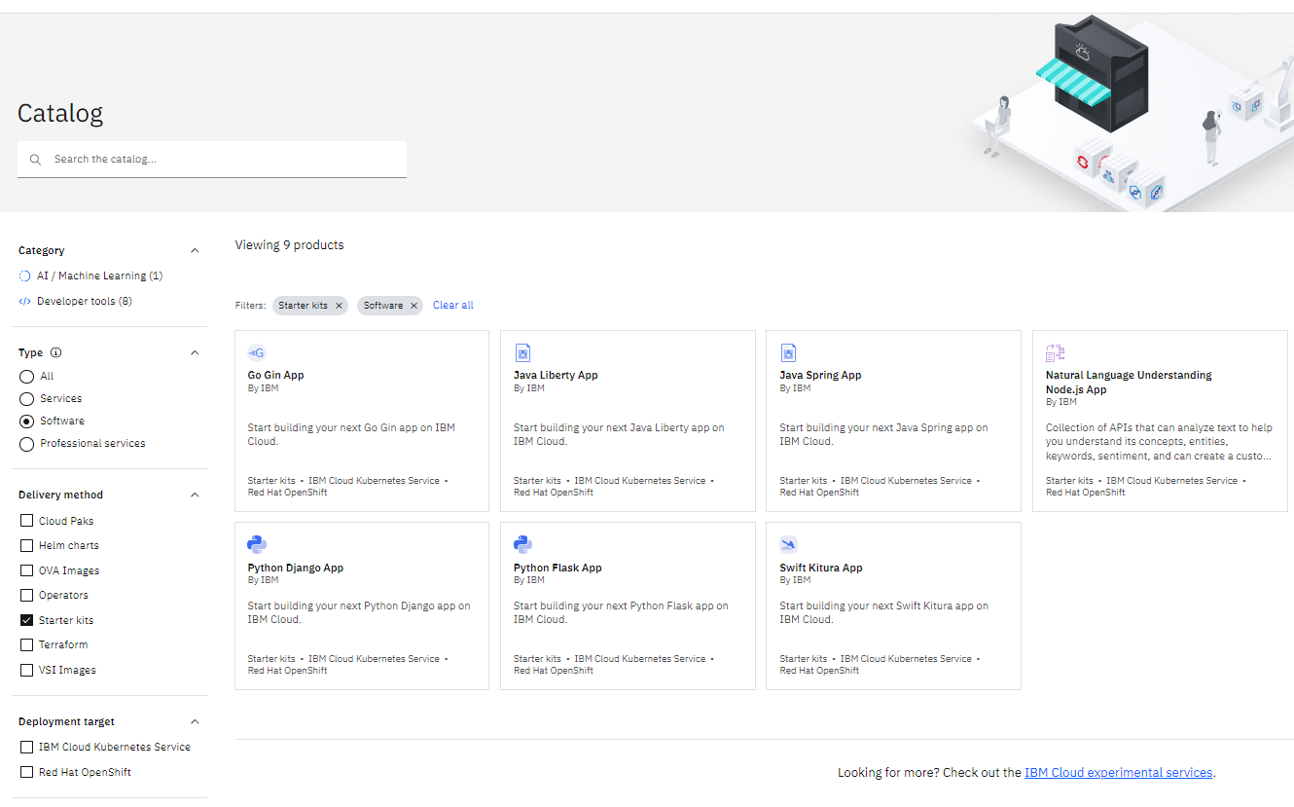
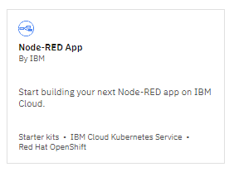
Add resource
On the Catalog page, select Type – Software, and Delivery Method – Starter Kit.
Then, select the NODE-RED APP

Slide 22
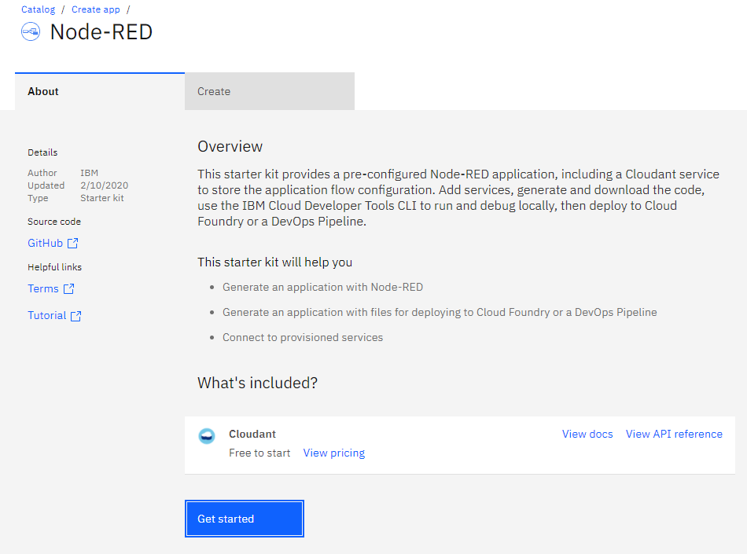
Get Started
Hit “Get Started”

Slide 23
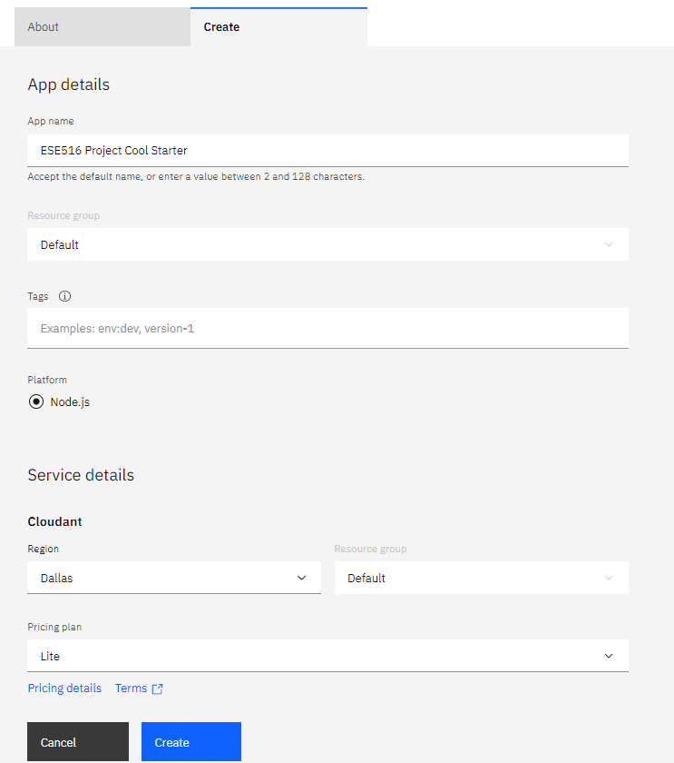
Set a name – any name!

Slide 24
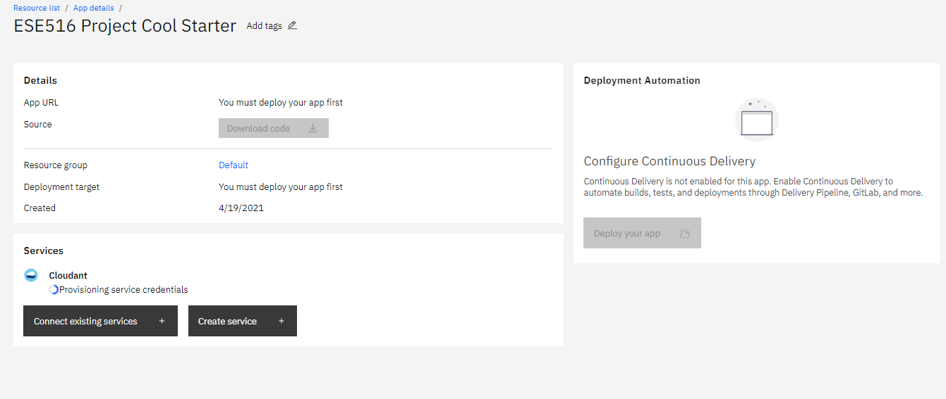
Wait a minute for system to load!

Slide 25
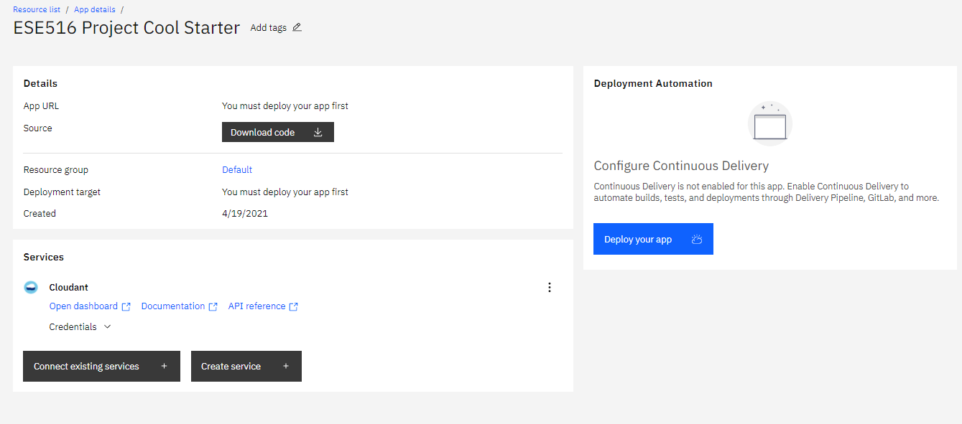
Click Deploy your app

Slide 26
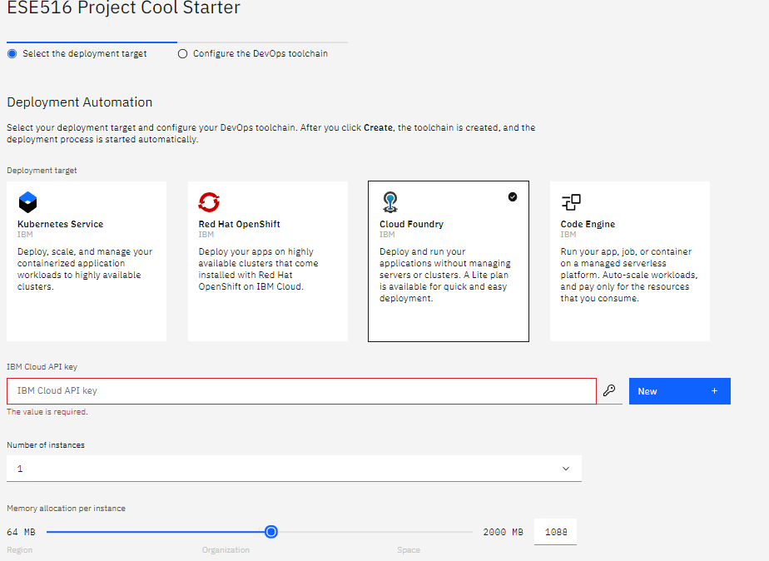
Select the following.
Press “New” to generate a key. You can copy it somewhere if you like.

Slide 27
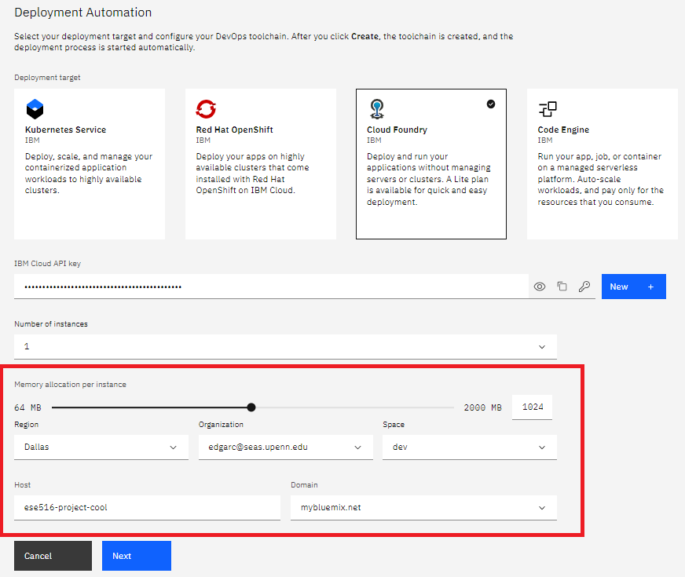
Give it 1024 MB of memory and hit next.
Do not provide more than 1 (one) GB of memory
Hit Next

Slide 28
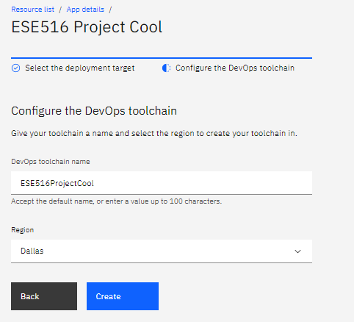

Slide 29
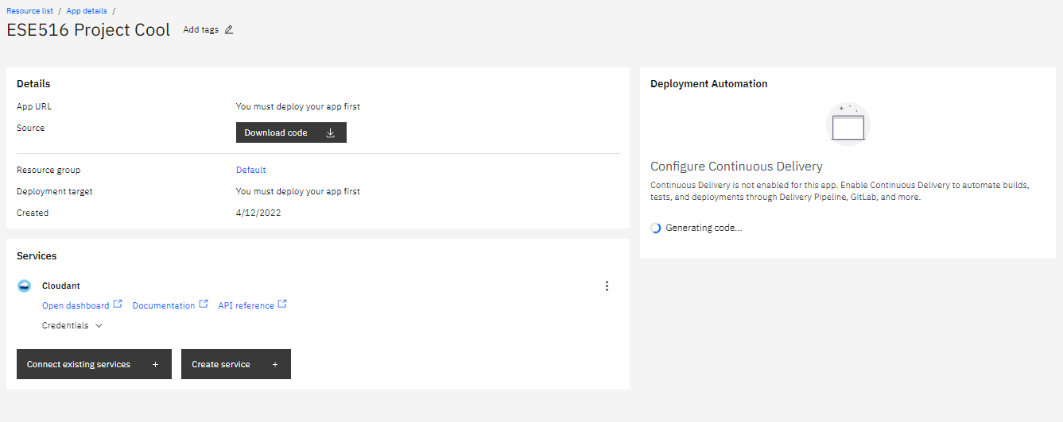
Wait a minute

Slide 30
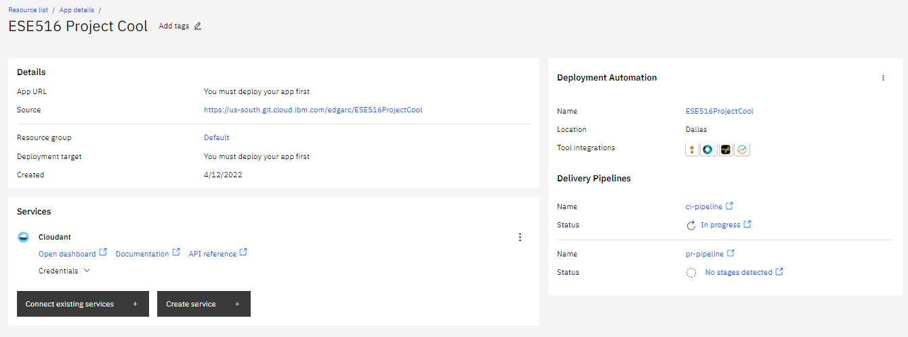
App will be deploying! Take a coffee 9-15 minute break – this will take a while, Mine took 12.5 minutes

Slide 31
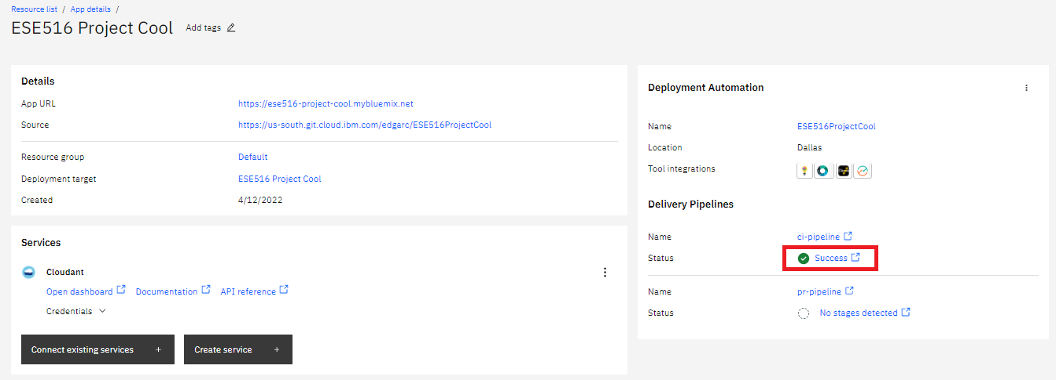
Done!

Slide 32
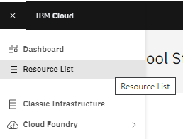
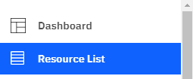
You can now access the resources made on the top left bar – under “Resource List”

Slide 33
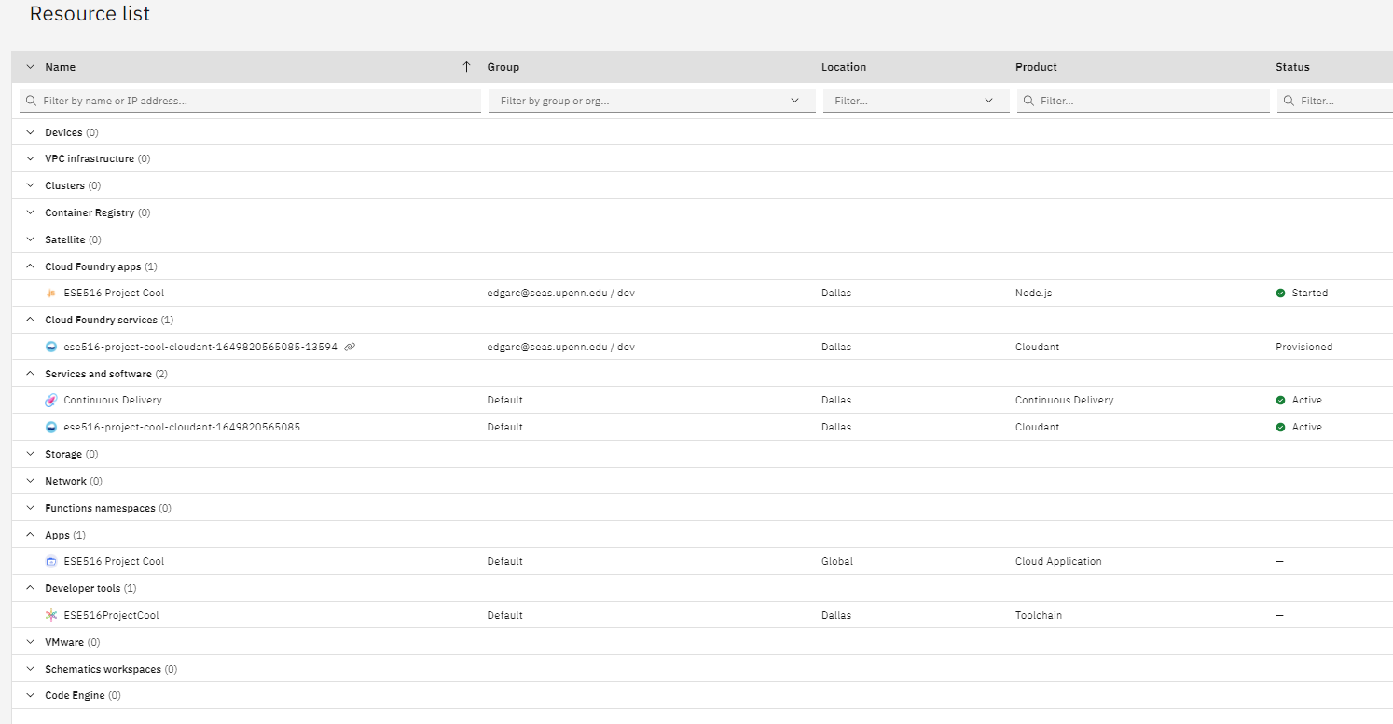
Node JS (For Node Red)
Here you can see the services started!
Node Red App (what we just compiled)
DB
Continuous Delivery

Slide 34
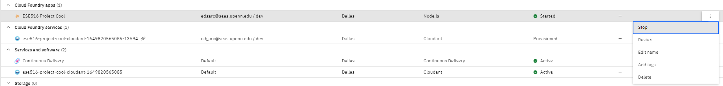
Before our next steps, we need to stop the current app. On the Could Foundry Apps, click on “Stop” to stop that process. You will encounter errors if you do not do this step.

Slide 35
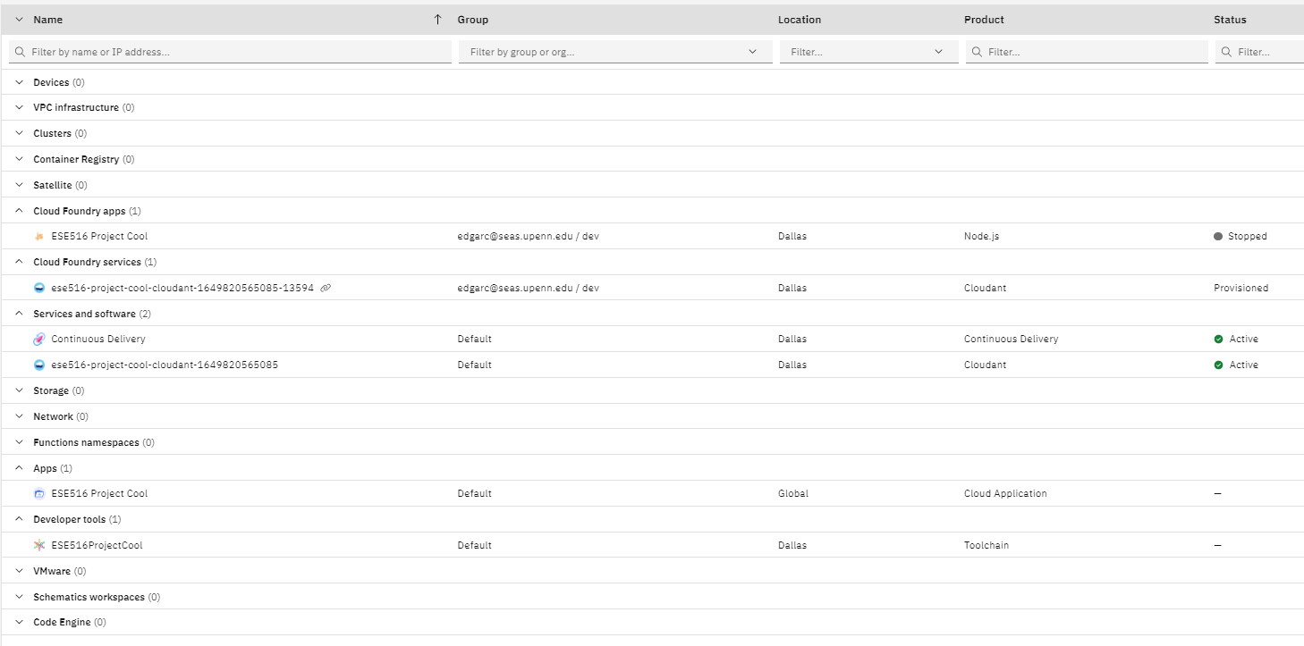
Before we begin, we have to install Node-Red modules for the system! Click on the Cloud Application under APPS

Slide 36
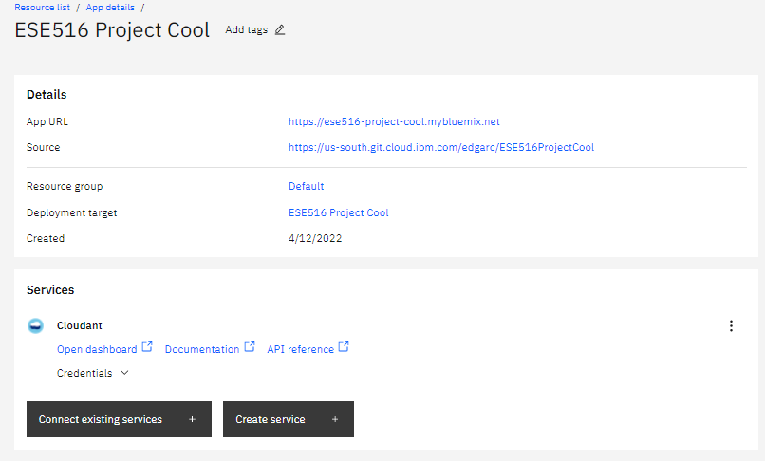
Here we will be able to access the Github project for our deployment. Click the link on the right as shown.

Slide 37
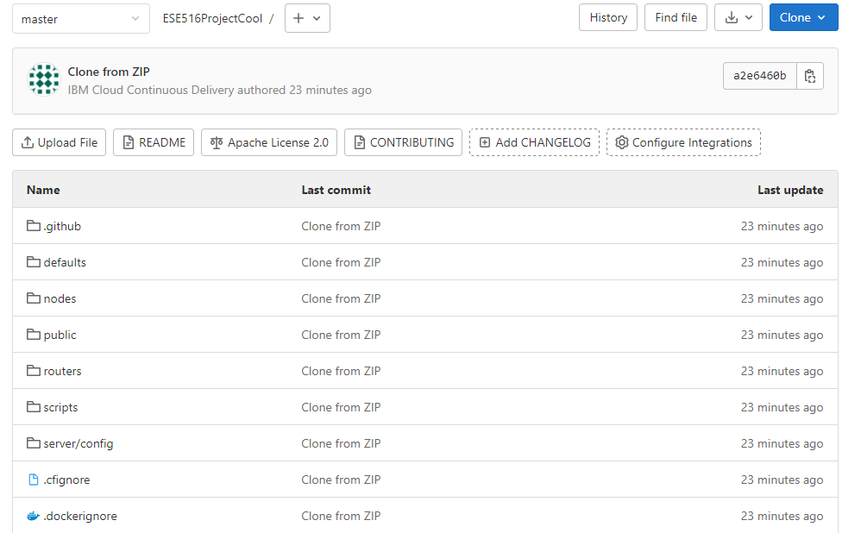
This will take you to a Github page with code for the Node-Red deployment.
We will modify one file:
Package.json: To install some useful NODE-RED nodes!

Slide 38
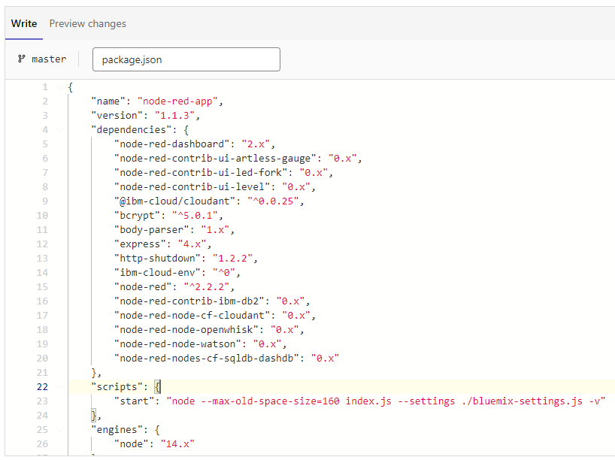
Open package.json
Hit “Edit”
Add the following at the very top of the dependencies:
"node-red-dashboard": "2.x",
"node-red-contrib-ui-artless-gauge": "0.x",
"node-red-contrib-ui-led-fork": "0.x",
"node-red-contrib-ui-level": "0.x",
Hit “Commit Changes”

Slide 39
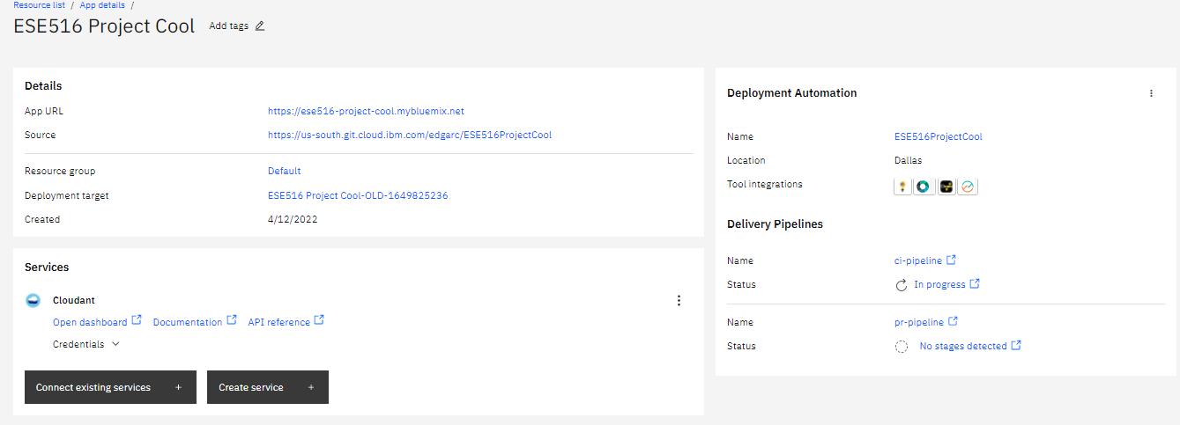
When you hit “Commit Changes”, the system will compile the project again. We need to wait until it compiles again. Click to see progress!

Slide 40
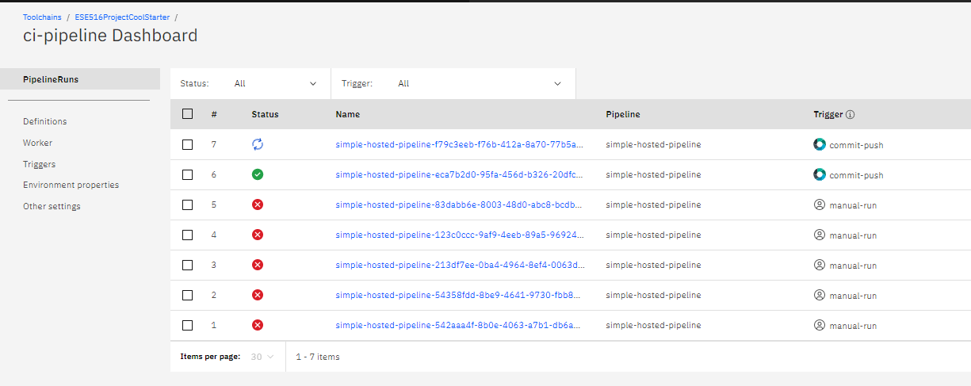
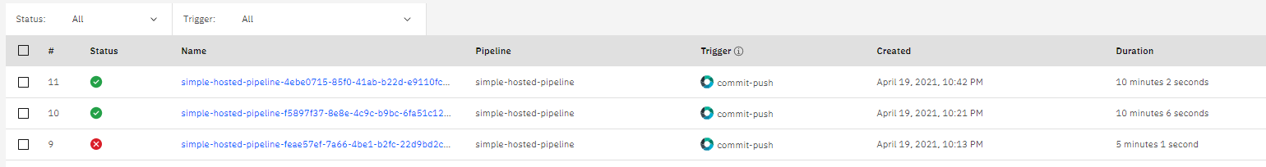
When you changed the code, it triggered an automatic rebuild. The system will tell you the state of the new build and deploy on the cloud. Wait until everything passed! If you had errors… Time for Piazza! It will take a while! ~ 5-10 min.
Yay! It passed!

Slide 41
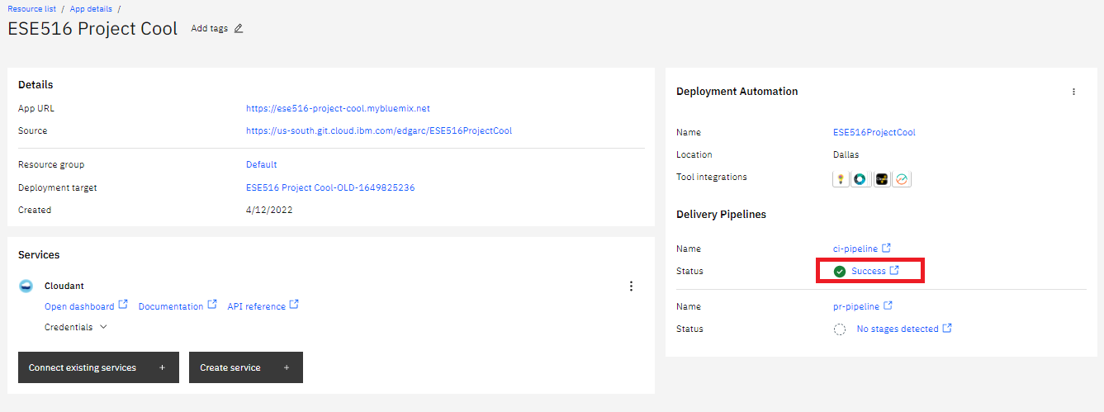
Success!
Yay! It passed!

Slide 42
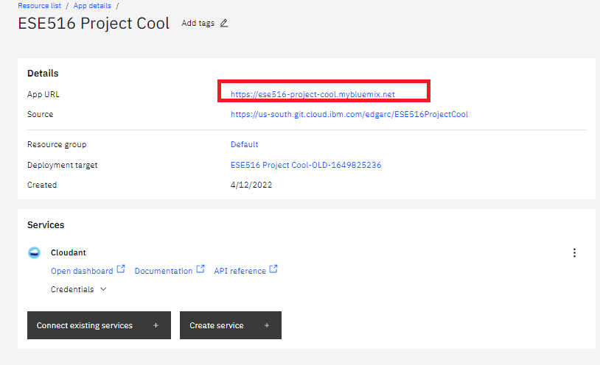
Go back and click this link. It will take you to the Node Red instance

Slide 43
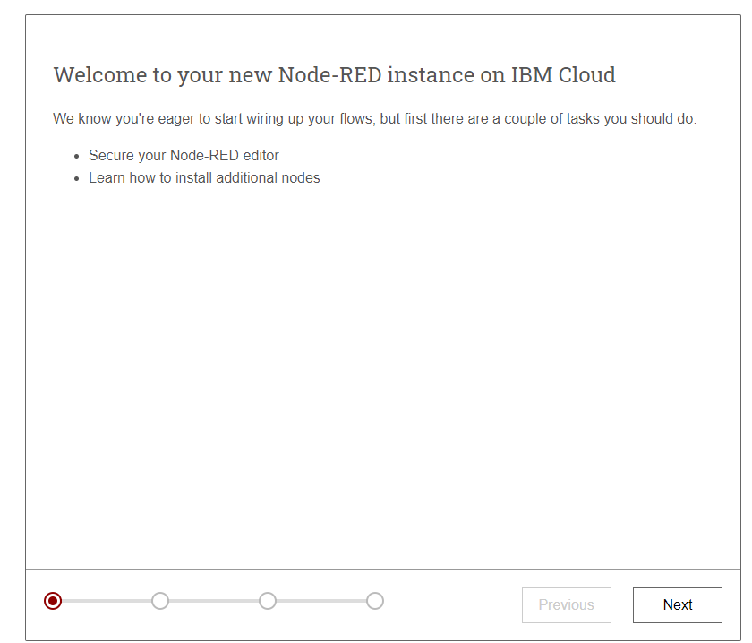
Go thru the next steps
Choose a password you can share with your class partner, and is easy to remember!

Slide 44
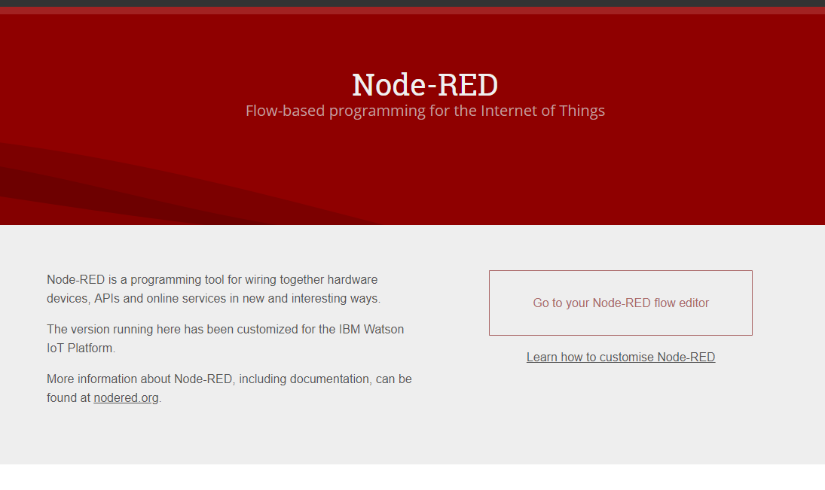
Node-Red
Your Node-Red is now ready! Click on the “Go To your Node-RED flow editor” to open the editor. Otherwise, click on “Learn how to customize Node RED” for a quick tutorial to start up.

Slide 45
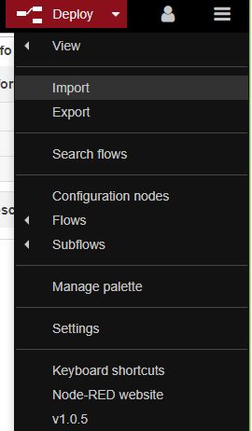
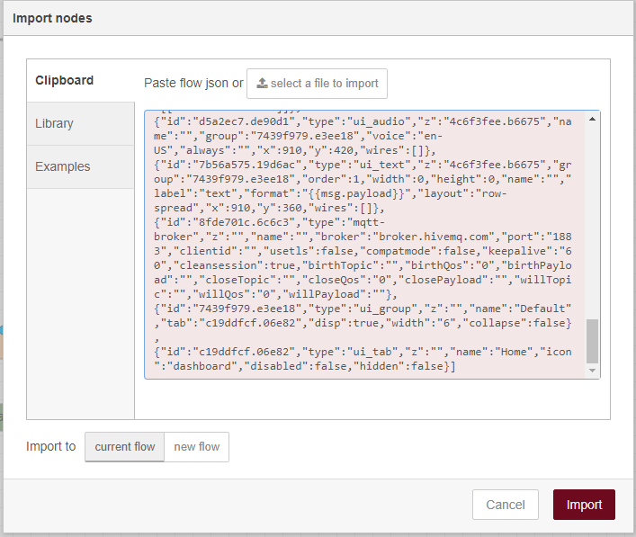
[{"id":"4c6f3fee.b6675","type":"tab","label":"Flow 1","disabled":false,"info":""},{"id":"5ac91ff3.86fef","type":"tab","label":"2 player game simulation","disabled":false,"info":""},{"id":"116f1ff.480b0e","type":"tab","label":"Simulation Game Board","disabled":false,"info":""},{"id":"8fde701c.6c6c3","type":"mqtt-broker","z":"","name":"","broker":"broker.hivemq.com","port":"1883","clientid":"","usetls":false,"compatmode":false,"keepalive":"60","cleansession":true,"birthTopic":"","birthQos":"0","birthPayload":"","closeTopic":"","closeQos":"0","closePayload":"","willTopic":"","willQos":"0","willPayload":""},{"id":"c19ddfcf.06e82","type":"ui_tab","z":"","name":"Home","icon":"dashboard","disabled":false,"hidden":false},{"id":"7439f979.e3ee18","type":"ui_group","z":"","name":"Default","tab":"c19ddfcf.06e82","disp":true,"width":"6","collapse":false},{"id":"3dd7f020.68187","type":"ui_base","theme":{"name":"theme-dark","lightTheme":{"default":"#0094CE","baseColor":"#0094CE","baseFont":"-apple-system,BlinkMacSystemFont,Segoe UI,Roboto,Oxygen-Sans,Ubuntu,Cantarell,Helvetica Neue,sans-serif","edited":true,"reset":false},"darkTheme":{"default":"#097479","baseColor":"#097479","baseFont":"-apple-system,BlinkMacSystemFont,Segoe UI,Roboto,Oxygen-Sans,Ubuntu,Cantarell,Helvetica Neue,sans-serif","edited":true,"reset":false},"customTheme":{"name":"Untitled Theme 1","default":"#4B7930","baseColor":"#4B7930","baseFont":"-apple-system,BlinkMacSystemFont,Segoe UI,Roboto,Oxygen-Sans,Ubuntu,Cantarell,Helvetica Neue,sans-serif"},"themeState":{"base-color":{"default":"#097479","value":"#097479","edited":false},"page-titlebar-backgroundColor":{"value":"#097479","edited":false},"page-backgroundColor":{"value":"#111111","edited":false},"page-sidebar-backgroundColor":{"value":"#000000","edited":false},"group-textColor":{"value":"#0eb8c0","edited":false},"group-borderColor":{"value":"#555555","edited":false},"group-backgroundColor":{"value":"#333333","edited":false},"widget-textColor":{"value":"#eeeeee","edited":false},"widget-backgroundColor":{"value":"#097479","edited":false},"widget-borderColor":{"value":"#333333","edited":false},"base-font":{"value":"-apple-system,BlinkMacSystemFont,Segoe UI,Roboto,Oxygen-Sans,Ubuntu,Cantarell,Helvetica Neue,sans-serif"}},"angularTheme":{"primary":"indigo","accents":"blue","warn":"red","background":"grey"}},"site":{"name":"Node-RED Dashboard","hideToolbar":"false","allowSwipe":"false","lockMenu":"false","allowTempTheme":"true","dateFormat":"DD/MM/YYYY","sizes":{"sx":48,"sy":48,"gx":4,"gy":4,"cx":6,"cy":6,"px":0,"py":0}}},{"id":"622b3681.b637e8","type":"ui_group","z":"","name":"2 Player Game Simulation","tab":"3c01459a.82910a","order":1,"disp":true,"width":"6","collapse":false},{"id":"3c01459a.82910a","type":"ui_tab","z":"","name":"2 Player Simulation","icon":"dashboard","order":2,"disabled":false,"hidden":false},{"id":"43e5bb99.cfe0e4","type":"ui_tab","z":"","name":"One Player Game","icon":"dashboard","order":3,"disabled":false,"hidden":false},{"id":"eff19175.c358e","type":"ui_group","z":"","name":"Color","tab":"43e5bb99.cfe0e4","order":1,"disp":true,"width":"6","collapse":false},{"id":"d7d463f4.cae2c","type":"ui_group","z":"","name":"P1 LED Board","tab":"3c01459a.82910a","order":2,"disp":true,"width":"4","collapse":false},{"id":"4c314b97.169624","type":"ui_spacer","name":"spacer","group":"d7d463f4.cae2c","order":2,"width":1,"height":1},{"id":"1980e43f.b4d11c","type":"function","z":"4c6f3fee.b6675","name":"temp","func":"return {payload:msg.payload.d.temp};","outputs":1,"noerr":0,"x":390,"y":480,"wires":[["48c3b8d0.9c3558"]]},{"id":"48c3b8d0.9c3558","type":"switch","z":"4c6f3fee.b6675","name":"temp thresh","property":"payload","propertyType":"msg","rules":[{"t":"lte","v":"40","vt":"str"},{"t":"gt","v":"40","vt":"str"}],"checkall":"true","repair":false,"outputs":2,"x":550,"y":480,"wires":[["5af543bd.70630c"],["c3eb20e6.6fb63"]]},{"id":"6e974680.39cd28","type":"debug","z":"4c6f3fee.b6675","name":"cpu status","active":false,"complete":"false","x":890,"y":480,"wires":[]},{"id":"ea07eb98.bc0448","type":"debug","z":"4c6f3fee.b6675","name":"device data","active":false,"console":"false","complete":"true","x":410,"y":560,"wires":[]},{"id":"5af543bd.70630c","type":"template","z":"4c6f3fee.b6675","name":"safe","field":"payload","fieldType":"msg","syntax":"mustache","template":"Temperature ({{payload}}) within safe limits","x":710,"y":460,"wires":[["6e974680.39cd28","7b56a575.19d6ac"]]},{"id":"c3eb20e6.6fb63","type":"template","z":"4c6f3fee.b6675","name":"danger","template":"Temperature ({{payload}}) critical","x":720,"y":500,"wires":[["6e974680.39cd28"]]},{"id":"3db4e4f7.4a9dfc","type":"inject","z":"4c6f3fee.b6675","name":"Send Data","topic":"","payload":"true","payloadType":"bool","repeat":"","crontab":"","once":false,"x":120,"y":140,"wires":[["20164732.524cf8"]]},{"id":"20164732.524cf8","type":"function","z":"4c6f3fee.b6675","name":"Device payload","func":"// Thermostat's location:\nvar longitude1 = -98.49;\nvar latitude1 = 29.42;\n\n// Array of pseudo random temperatures\nvar temp1 = [15,17,18.5,20,21.5,23,24,22.2,19,18];\n\n// Array of pseudo random relative humidities\nvar humidity1 = [50,55,61,68,65,60,53,49,45,47];\n\n// Counter to select from array.\nvar counter1 = context.get('counter1')||0;\ncounter1 = counter1+1;\nif(counter1 > 9) counter1 = 0;\ncontext.set('counter1',counter1);\n\n// Create MQTT message in JSON\nmsg = {\n payload: JSON.stringify(\n {\n d:{\n \"temp\" : temp1[counter1],\n \"humidity\" : humidity1[counter1],\n \"location\" :\n {\n \"longitude\" : longitude1,\n \"latitude\" : latitude1\n },\n }\n }\n )\n};\nreturn msg;\n","outputs":1,"noerr":0,"x":340,"y":140,"wires":[["5f9f3a85.1b8ff4","d632271c.8819e8"]]},{"id":"5f9f3a85.1b8ff4","type":"debug","z":"4c6f3fee.b6675","name":"Debug output payload","active":false,"console":"false","complete":"payload","x":580,"y":200,"wires":[]},{"id":"33e5da99.a54c16","type":"comment","z":"4c6f3fee.b6675","name":"Device Simulator","info":"Sends simulated device sensor data to IBM Watson IoT Plaform.\n\nCan be configured to send on click or on an automatic interval.\n\n\n#Prerequisite\nOutput node device type and device ID need to match a device that it registered in a running IBM Watson IoT Platform service.\n\n# Watson IoT Platform docs\n[Connecting devices](https://www.bluemix.net/docs/services/IoT/iotplatform_task.html)","x":120,"y":60,"wires":[]},{"id":"c742e956.a93c08","type":"comment","z":"4c6f3fee.b6675","name":"1. Configure target","info":"","x":570,"y":100,"wires":[]},{"id":"eee1d834.9e4158","type":"comment","z":"4c6f3fee.b6675","name":"2. Click to send data","info":"To automatically send data:\n1. Change *Repeat* to interval.\n2. Click Deploy button.\n","x":130,"y":180,"wires":[]},{"id":"5f5d259.a7f9cdc","type":"comment","z":"4c6f3fee.b6675","name":"Temperature Monitor","info":"","x":210,"y":380,"wires":[]},{"id":"f573da3c.d9d7d8","type":"comment","z":"4c6f3fee.b6675","name":"Configure source","info":"","x":200,"y":440,"wires":[]},{"id":"cea7b111.fe71b","type":"json","z":"4c6f3fee.b6675","name":"","property":"payload","action":"","pretty":false,"x":230,"y":480,"wires":[["1980e43f.b4d11c","ea07eb98.bc0448"]]},{"id":"d632271c.8819e8","type":"mqtt out","z":"4c6f3fee.b6675","name":"","topic":"TempData","qos":"1","retain":"","broker":"8fde701c.6c6c3","x":790,"y":140,"wires":[]},{"id":"7b56a575.19d6ac","type":"ui_text","z":"4c6f3fee.b6675","group":"7439f979.e3ee18","order":1,"width":0,"height":0,"name":"","label":"text","format":"{{msg.payload}}","layout":"row-spread","x":910,"y":360,"wires":[]},{"id":"c0b9a71b.9ea2b8","type":"function","z":"5ac91ff3.86fef","name":"Add Play","func":"\nif(msg.payload.game.length <= 20){\n \n //Concatenate a play\n msg.payload.game.push(Math.round(Math.random()*15))\n \n}\nelse{\n //Pop out first game in list and add a new one at the end\n msg.payload.game.shift(); // Remove an item from the beginning of an array.\n msg.payload.game.push(Math.round(Math.random()*15))\n}\n\n\nreturn msg","outputs":1,"noerr":0,"x":560,"y":320,"wires":[["4004f32f.841acc","6a2ba603.56a918","285e1be5.e64a54"]]},{"id":"4004f32f.841acc","type":"debug","z":"5ac91ff3.86fef","name":"Debug output payload","active":false,"tosidebar":true,"console":false,"tostatus":false,"complete":"payload","targetType":"msg","x":840,"y":360,"wires":[]},{"id":"512750c.59b06b","type":"comment","z":"5ac91ff3.86fef","name":"Device Simulator - Press to Start a New Game","info":"Sends simulated device sensor data to IBM Watson IoT Plaform.\n\nCan be configured to send on click or on an automatic interval.\n\n\n#Prerequisite\nOutput node device type and device ID need to match a device that it registered in a running IBM Watson IoT Platform service.\n\n# Watson IoT Platform docs\n[Connecting devices](https://www.bluemix.net/docs/services/IoT/iotplatform_task.html)","x":270,"y":40,"wires":[]},{"id":"f996af79.0680f","type":"comment","z":"5ac91ff3.86fef","name":"Add move to P1 and send to P2","info":"","x":190,"y":240,"wires":[]},{"id":"df42a169.95838","type":"mqtt out","z":"5ac91ff3.86fef","name":"","topic":"P1_GAME_ESE516_T0","qos":"1","retain":"","broker":"8fde701c.6c6c3","x":750,"y":40,"wires":[]},{"id":"ca8ced29.a967c","type":"inject","z":"5ac91ff3.86fef","name":"","topic":"","payload":"{\"game\":[0]}","payloadType":"json","repeat":"","crontab":"","once":false,"onceDelay":0.1,"x":190,"y":80,"wires":[["bf064806.f9d048"]]},{"id":"a499c6df.4fc628","type":"debug","z":"5ac91ff3.86fef","name":"Debug output payload","active":false,"console":"false","complete":"payload","x":740,"y":100,"wires":[]},{"id":"aa913e41.84da","type":"mqtt in","z":"5ac91ff3.86fef","name":"","topic":"P1_GAME_ESE516_T0","qos":"1","datatype":"auto","broker":"8fde701c.6c6c3","x":200,"y":340,"wires":[["3f1df67f.27042a","cdc8ef25.6f588"]]},{"id":"3f1df67f.27042a","type":"debug","z":"5ac91ff3.86fef","name":"Debug output payload","active":false,"console":"false","complete":"payload","x":460,"y":460,"wires":[]},{"id":"cb535277.c48ac","type":"debug","z":"5ac91ff3.86fef","name":"Debug output payload","active":false,"tosidebar":true,"console":false,"tostatus":false,"complete":"payload","targetType":"msg","x":600,"y":400,"wires":[]},{"id":"cdc8ef25.6f588","type":"json","z":"5ac91ff3.86fef","name":"","property":"payload","action":"","pretty":false,"x":410,"y":320,"wires":[["c0b9a71b.9ea2b8","cb535277.c48ac"]]},{"id":"6a2ba603.56a918","type":"mqtt out","z":"5ac91ff3.86fef","name":"","topic":"P2_GAME_ESE516_T0","qos":"1","retain":"","broker":"8fde701c.6c6c3","x":870,"y":280,"wires":[]},{"id":"f924ab3.23dd358","type":"mqtt in","z":"5ac91ff3.86fef","name":"","topic":"P2_GAME_ESE516_T0","qos":"1","datatype":"auto","broker":"8fde701c.6c6c3","x":200,"y":600,"wires":[["a676c449.c87e88","a9b58c3.b276f7"]]},{"id":"5bcf18fa.29cbd8","type":"function","z":"5ac91ff3.86fef","name":"Add Play","func":"\nif(msg.payload.game.length <= 20){\n \n //Concatenate a play\n msg.payload.game.push(Math.round(Math.random()*15))\n \n}\nelse{\n //Pop out first game in list and add a new one at the end\n msg.payload.game.shift(); // Remove an item from the beginning of an array.\n msg.payload.game.push(Math.round(Math.random()*15))\n}\n\n\nreturn msg","outputs":1,"noerr":0,"x":580,"y":600,"wires":[["300afcfa.6035e4","e4c6da55.0408d8","229d5f64.5c929"]]},{"id":"300afcfa.6035e4","type":"debug","z":"5ac91ff3.86fef","name":"Debug output payload","active":false,"tosidebar":true,"console":false,"tostatus":false,"complete":"payload","targetType":"msg","x":820,"y":700,"wires":[]},{"id":"a9b58c3.b276f7","type":"debug","z":"5ac91ff3.86fef","name":"Debug output payload","active":false,"console":"false","complete":"payload","x":380,"y":740,"wires":[]},{"id":"885aa766.0de178","type":"debug","z":"5ac91ff3.86fef","name":"Debug output payload","active":false,"tosidebar":true,"console":false,"tostatus":false,"complete":"payload","targetType":"msg","x":540,"y":680,"wires":[]},{"id":"a676c449.c87e88","type":"json","z":"5ac91ff3.86fef","name":"","property":"payload","action":"","pretty":false,"x":430,"y":600,"wires":[["5bcf18fa.29cbd8","885aa766.0de178"]]},{"id":"54dd8cf6.8f1434","type":"mqtt out","z":"5ac91ff3.86fef","name":"","topic":"P1_GAME_ESE516_T0","qos":"1","retain":"","broker":"8fde701c.6c6c3","x":570,"y":880,"wires":[]},{"id":"e174c289.77e3e","type":"ui_button","z":"5ac91ff3.86fef","name":"","group":"622b3681.b637e8","order":1,"width":0,"height":0,"passthru":false,"label":"Simulate Turn","tooltip":"","color":"","bgcolor":"","icon":"","payload":"","payloadType":"str","topic":"","x":140,"y":913,"wires":[["cfad289c.cedd48"]]},{"id":"e4c6da55.0408d8","type":"change","z":"5ac91ff3.86fef","name":"","rules":[{"t":"set","p":"message1","pt":"global","to":"payload","tot":"msg"}],"action":"","property":"","from":"","to":"","reg":false,"x":840,"y":580,"wires":[[]]},{"id":"cfad289c.cedd48","type":"change","z":"5ac91ff3.86fef","name":"","rules":[{"t":"set","p":"payload","pt":"msg","to":"message1","tot":"global"}],"action":"","property":"","from":"","to":"","reg":false,"x":360,"y":893,"wires":[["54dd8cf6.8f1434"]]},{"id":"68983335.0e7d1c","type":"comment","z":"5ac91ff3.86fef","name":"Add move to P2 and send to P1 when BUTTON is press","info":"","x":240,"y":540,"wires":[]},{"id":"bc2624d3.a95a38","type":"comment","z":"5ac91ff3.86fef","name":"Simulate Turn","info":"","x":110,"y":820,"wires":[]},{"id":"285e1be5.e64a54","type":"ui_text","z":"5ac91ff3.86fef","group":"622b3681.b637e8","order":1,"width":0,"height":0,"name":"","label":"P1 Move","format":"{{msg.payload}}","layout":"row-spread","x":850,"y":220,"wires":[]},{"id":"229d5f64.5c929","type":"ui_text","z":"5ac91ff3.86fef","group":"622b3681.b637e8","order":1,"width":0,"height":0,"name":"","label":"P2 Move","format":"{{msg.payload}}","layout":"row-spread","x":820,"y":640,"wires":[]},{"id":"bf064806.f9d048","type":"ui_button","z":"5ac91ff3.86fef","name":"","group":"622b3681.b637e8","order":1,"width":0,"height":0,"passthru":true,"label":"Initialize Game","tooltip":"","color":"","bgcolor":"","icon":"","payload":"{\"game\":[0]}","payloadType":"str","topic":"","x":440,"y":80,"wires":[["df42a169.95838","a499c6df.4fc628"]]},{"id":"d16fab0f.782708","type":"comment","z":"116f1ff.480b0e","name":"Animate Play","info":"","x":90,"y":240,"wires":[]},{"id":"c05aed9b.ab7db","type":"debug","z":"116f1ff.480b0e","name":"Debug output payload","active":true,"console":"false","complete":"payload","x":560,"y":500,"wires":[]},{"id":"4cc0ab2a.88b434","type":"ui_led","z":"116f1ff.480b0e","group":"d7d463f4.cae2c","order":1,"width":"1","height":"1","label":"","labelPlacement":"left","labelAlignment":"left","colorForValue":[{"color":"red","value":"false","valueType":"bool"},{"color":"green","value":"true","valueType":"bool"}],"allowColorForValueInMessage":false,"name":"Led1","x":1270,"y":100,"wires":[]},{"id":"f9b26a67.5cf388","type":"ui_led","z":"116f1ff.480b0e","group":"d7d463f4.cae2c","order":1,"width":"1","height":"1","label":"","labelPlacement":"left","labelAlignment":"left","colorForValue":[{"color":"red","value":"false","valueType":"bool"},{"color":"green","value":"true","valueType":"bool"}],"allowColorForValueInMessage":false,"name":"Led2","x":1270,"y":140,"wires":[]},{"id":"bd8f2b7c.6796e8","type":"ui_led","z":"116f1ff.480b0e","group":"d7d463f4.cae2c","order":1,"width":"1","height":"1","label":"","labelPlacement":"left","labelAlignment":"left","colorForValue":[{"color":"red","value":"false","valueType":"bool"},{"color":"green","value":"true","valueType":"bool"}],"allowColorForValueInMessage":false,"name":"Led3","x":1270,"y":180,"wires":[]},{"id":"c86d8d18.d96ed","type":"ui_led","z":"116f1ff.480b0e","group":"d7d463f4.cae2c","order":1,"width":"1","height":"1","label":"","labelPlacement":"left","labelAlignment":"left","colorForValue":[{"color":"red","value":"false","valueType":"bool"},{"color":"green","value":"true","valueType":"bool"}],"allowColorForValueInMessage":false,"name":"Led4","x":1270,"y":220,"wires":[]},{"id":"a8e0b200.dc4ed","type":"ui_led","z":"116f1ff.480b0e","group":"d7d463f4.cae2c","order":1,"width":"1","height":"1","label":"","labelPlacement":"left","labelAlignment":"left","colorForValue":[{"color":"red","value":"false","valueType":"bool"},{"color":"green","value":"true","valueType":"bool"}],"allowColorForValueInMessage":false,"name":"Led5","x":1270,"y":260,"wires":[]},{"id":"f0a50ac5.90c7b8","type":"ui_led","z":"116f1ff.480b0e","group":"d7d463f4.cae2c","order":1,"width":"1","height":"1","label":"","labelPlacement":"left","labelAlignment":"left","colorForValue":[{"color":"red","value":"false","valueType":"bool"},{"color":"green","value":"true","valueType":"bool"}],"allowColorForValueInMessage":false,"name":"Led6","x":1270,"y":300,"wires":[]},{"id":"b21ac57f.faad88","type":"ui_led","z":"116f1ff.480b0e","group":"d7d463f4.cae2c","order":1,"width":"1","height":"1","label":"","labelPlacement":"left","labelAlignment":"left","colorForValue":[{"color":"red","value":"false","valueType":"bool"},{"color":"green","value":"true","valueType":"bool"}],"allowColorForValueInMessage":false,"name":"Led7","x":1270,"y":340,"wires":[]},{"id":"ac0ec6c3.755758","type":"ui_led","z":"116f1ff.480b0e","group":"d7d463f4.cae2c","order":1,"width":"1","height":"1","label":"","labelPlacement":"left","labelAlignment":"left","colorForValue":[{"color":"red","value":"false","valueType":"bool"},{"color":"green","value":"true","valueType":"bool"}],"allowColorForValueInMessage":false,"name":"Led8","x":1270,"y":380,"wires":[]},{"id":"2b88fff0.d9844","type":"ui_led","z":"116f1ff.480b0e","group":"d7d463f4.cae2c","order":1,"width":"1","height":"1","label":"","labelPlacement":"left","labelAlignment":"left","colorForValue":[{"color":"red","value":"false","valueType":"bool"},{"color":"green","value":"true","valueType":"bool"}],"allowColorForValueInMessage":false,"name":"Led9","x":1270,"y":420,"wires":[]},{"id":"82382e0b.fa71b","type":"ui_led","z":"116f1ff.480b0e","group":"d7d463f4.cae2c","order":1,"width":"1","height":"1","label":"","labelPlacement":"left","labelAlignment":"left","colorForValue":[{"color":"red","value":"false","valueType":"bool"},{"color":"green","value":"true","valueType":"bool"}],"allowColorForValueInMessage":false,"name":"Led10","x":1270,"y":460,"wires":[]},{"id":"950d5279.e6a1a","type":"ui_led","z":"116f1ff.480b0e","group":"d7d463f4.cae2c","order":1,"width":"1","height":"1","label":"","labelPlacement":"left","labelAlignment":"left","colorForValue":[{"color":"red","value":"false","valueType":"bool"},{"color":"green","value":"true","valueType":"bool"}],"allowColorForValueInMessage":false,"name":"Led11","x":1270,"y":500,"wires":[]},{"id":"ac0f2d76.c8a64","type":"ui_led","z":"116f1ff.480b0e","group":"d7d463f4.cae2c","order":1,"width":"1","height":"1","label":"","labelPlacement":"left","labelAlignment":"left","colorForValue":[{"color":"red","value":"false","valueType":"bool"},{"color":"green","value":"true","valueType":"bool"}],"allowColorForValueInMessage":false,"name":"Led12","x":1270,"y":540,"wires":[]},{"id":"7bf92286.7a891c","type":"ui_led","z":"116f1ff.480b0e","group":"d7d463f4.cae2c","order":1,"width":"1","height":"1","label":"","labelPlacement":"left","labelAlignment":"left","colorForValue":[{"color":"red","value":"false","valueType":"bool"},{"color":"green","value":"true","valueType":"bool"}],"allowColorForValueInMessage":false,"name":"Led13","x":1270,"y":580,"wires":[]},{"id":"f0e0de4e.3c93d","type":"ui_led","z":"116f1ff.480b0e","group":"d7d463f4.cae2c","order":1,"width":"1","height":"1","label":"","labelPlacement":"left","labelAlignment":"left","colorForValue":[{"color":"red","value":"false","valueType":"bool"},{"color":"green","value":"true","valueType":"bool"}],"allowColorForValueInMessage":false,"name":"Led14","x":1270,"y":620,"wires":[]},{"id":"9df0706.839de9","type":"ui_led","z":"116f1ff.480b0e","group":"d7d463f4.cae2c","order":1,"width":"1","height":"1","label":"","labelPlacement":"left","labelAlignment":"left","colorForValue":[{"color":"red","value":"false","valueType":"bool"},{"color":"green","value":"true","valueType":"bool"}],"allowColorForValueInMessage":false,"name":"Led15","x":1270,"y":660,"wires":[]},{"id":"b1a93491.7b7948","type":"ui_led","z":"116f1ff.480b0e","group":"d7d463f4.cae2c","order":1,"width":"1","height":"1","label":"","labelPlacement":"left","labelAlignment":"left","colorForValue":[{"color":"red","value":"false","valueType":"bool"},{"color":"green","value":"true","valueType":"bool"}],"allowColorForValueInMessage":false,"name":"Led16","x":1270,"y":700,"wires":[]},{"id":"1d3c5dd4.892ae2","type":"split","z":"116f1ff.480b0e","name":"","splt":" ","spltType":"str","arraySplt":1,"arraySpltType":"len","stream":false,"addname":"","x":490,"y":220,"wires":[["24e73d6a.04f4b2"]]},{"id":"29d0818d.68588e","type":"delay","z":"116f1ff.480b0e","name":"","pauseType":"rate","timeout":"1","timeoutUnits":"seconds","rate":"1","nbRateUnits":"1","rateUnits":"second","randomFirst":"1","randomLast":"5","randomUnits":"seconds","drop":false,"x":750,"y":280,"wires":[["d30cfd4f.67b37","3a37c28f.ff8e2e"]]},{"id":"7167d561.2eca6c","type":"mqtt in","z":"116f1ff.480b0e","name":"","topic":"P2_GAME_ESE516_T0","qos":"1","datatype":"auto","broker":"8fde701c.6c6c3","x":100,"y":340,"wires":[["63059394.4cf9ec"]]},{"id":"d30cfd4f.67b37","type":"debug","z":"116f1ff.480b0e","name":"Debug output payload","active":true,"console":"false","complete":"payload","x":940,"y":580,"wires":[]},{"id":"63059394.4cf9ec","type":"json","z":"116f1ff.480b0e","name":"","property":"payload","action":"","pretty":false,"x":290,"y":340,"wires":[["c05aed9b.ab7db","e62ea6ab.bd4a28"]]},{"id":"24e73d6a.04f4b2","type":"split","z":"116f1ff.480b0e","name":"","splt":" ","spltType":"str","arraySplt":1,"arraySpltType":"len","stream":false,"addname":"topic","x":610,"y":280,"wires":[["29d0818d.68588e"]]},{"id":"764ea03a.3afae","type":"debug","z":"116f1ff.480b0e","name":"Debug output payload","active":true,"console":"false","complete":"payload","x":1300,"y":60,"wires":[]},{"id":"3a37c28f.ff8e2e","type":"function","z":"116f1ff.480b0e","name":"","func":"var on = { payload: true};\nvar off = { payload: false};\n\n\nif(msg.payload === 0)\n{\n return [on, off, off, off, off, off, off, off, off, off, off, off, off, off, off, off]; \n \n}\nelse if(msg.payload === 1)\n{\n return [off, on, off, off, off, off, off, off, off, off, off, off, off, off, off, off]; \n \n}\nelse if(msg.payload === 2)\n{\n return [off, off, on, off, off, off, off, off, off, off, off, off, off, off, off, off]; \n \n}\nelse if(msg.payload === 3)\n{\n return [off, off, off, on, off, off, off, off, off, off, off, off, off, off, off, off]; \n \n}\nelse if(msg.payload === 4)\n{\n return [off, off, off, off, on, off, off, off, off, off, off, off, off, off, off, off]; \n \n}\nelse if(msg.payload === 5)\n{\n return [off, off, off, off, off, on, off, off, off, off, off, off, off, off, off, off]; \n \n}\nelse if(msg.payload === 6)\n{\n return [off, off, off, off, off, off, on, off, off, off, off, off, off, off, off, off]; \n \n}\nelse if(msg.payload === 7)\n{\n return [off, off, off, off, off, off, off, on, off, off, off, off, off, off, off, off]; \n \n}\nelse if(msg.payload === 8)\n{\n return [off, off, off, off, off, off, off, off, on, off, off, off, off, off, off, off]; \n \n}\nelse if(msg.payload === 9)\n{\n return [off, off, off, off, off, off, off, off, off, on, off, off, off, off, off, off]; \n \n}\nelse if(msg.payload === 10)\n{\n return [off, off, off, off, off, off, off, off, off, off, on, off, off, off, off, off]; \n \n}\nelse if(msg.payload === 11)\n{\n return [off, off, off, off, off, off, off, off, off, on, off, off, off, off, off, off]; \n \n}\nelse if(msg.payload === 12)\n{\n return [off, off, off, off, off, off, off, off, off, off, on, off, off, off, off, off]; \n \n}\nelse if(msg.payload === 13)\n{\n return [off, off, off, off, off, off, off, off, off, off, off, on, off, off, off, off]; \n \n}\nelse if(msg.payload === 14)\n{\n return [off, off, off, off, off, off, off, off, off, off, off, off, on, off, off, off]; \n \n}\nelse if(msg.payload === 15)\n{\n return [off, off, off, off, off, off, off, off, off, off, off, off, off, on, off, off]; \n \n}\nelse\n{\n return [off, off, off, off, off, off, off, off, off, off, off, off, off, off, off, off]; \n \n}\n","outputs":16,"noerr":0,"x":960,"y":280,"wires":[["4cc0ab2a.88b434","764ea03a.3afae"],["f9b26a67.5cf388"],["bd8f2b7c.6796e8"],["c86d8d18.d96ed"],["a8e0b200.dc4ed"],["f0a50ac5.90c7b8"],["b21ac57f.faad88"],["ac0ec6c3.755758"],["2b88fff0.d9844"],["82382e0b.fa71b"],["950d5279.e6a1a"],["ac0f2d76.c8a64"],["7bf92286.7a891c"],["f0e0de4e.3c93d"],["9df0706.839de9"],["b1a93491.7b7948"]]},{"id":"e62ea6ab.bd4a28","type":"function","z":"116f1ff.480b0e","name":"","func":"msg.payload.game.push(16) //Add 16 at end to turn of system\nreturn msg;","outputs":1,"noerr":0,"x":380,"y":300,"wires":[["1d3c5dd4.892ae2"]]},{"id":"86610934.402028","type":"mqtt in","z":"4c6f3fee.b6675","name":"","topic":"P1_IMU_ESE516_T0","qos":"2","datatype":"auto","broker":"8fde701c.6c6c3","x":210,"y":720,"wires":[["ea8af28d.45304"]]},{"id":"ea8af28d.45304","type":"debug","z":"4c6f3fee.b6675","name":"device data","active":true,"console":"false","complete":"true","x":490,"y":720,"wires":[]},{"id":"a927dcb5.67b9d","type":"mqtt in","z":"4c6f3fee.b6675","name":"","topic":"P1_DISTANCE_ESE516_T0","qos":"2","datatype":"auto","broker":"8fde701c.6c6c3","x":220,"y":780,"wires":[["c9383b30.7f6f08"]]},{"id":"c9383b30.7f6f08","type":"debug","z":"4c6f3fee.b6675","name":"device data","active":true,"console":"false","complete":"true","x":490,"y":780,"wires":[]},{"id":"7df6438c.847edc","type":"ui_colour_picker","z":"116f1ff.480b0e","name":"","label":"LED Color","group":"622b3681.b637e8","format":"rgb","outformat":"string","showSwatch":true,"showPicker":false,"showValue":false,"showHue":false,"showAlpha":false,"showLightness":true,"square":"false","dynOutput":"false","order":1,"width":"1","height":"1","passthru":true,"topic":"","x":150,"y":100,"wires":[["d1853f0f.40862","22e5bff9.6f8aa"]]},{"id":"d1853f0f.40862","type":"debug","z":"116f1ff.480b0e","name":"Debug output payload","active":true,"console":"false","complete":"payload","x":480,"y":100,"wires":[]},{"id":"22e5bff9.6f8aa","type":"mqtt out","z":"116f1ff.480b0e","name":"","topic":"P1_LED_ESE516_T0","qos":"1","retain":"","broker":"8fde701c.6c6c3","x":480,"y":40,"wires":[]}]
Copy this text!

Slide 46
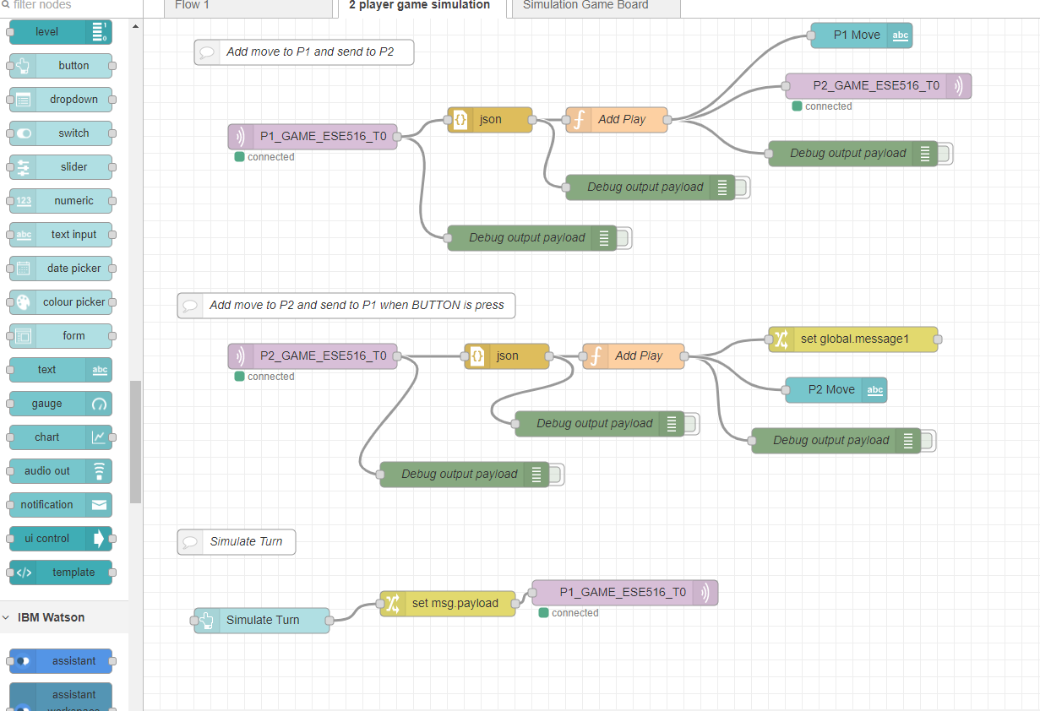
Node-Red
You should now have the ESE516 Simulator on your flow. Take some time to explore what is going on! The next slider will explain some of the most important nodes.

Slide 47

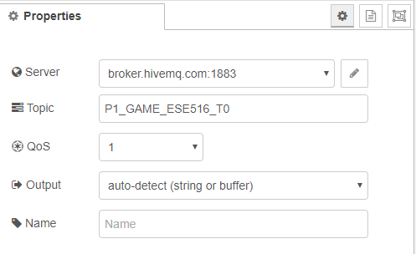
Node-Red – MQTT IN
MQTT Node: The MQTT IN NODE listens to a command received from a broker. If you double click it you can edit what it listens to! Notice that it is connected to the MQTT broker we mentioned before, and is listening to the P1_GAME_ESE516_T0. You will need to change this T0 to a unique number so it does not conflict with your colleagues!

Slide 48
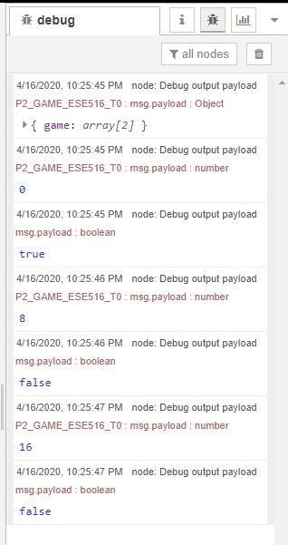

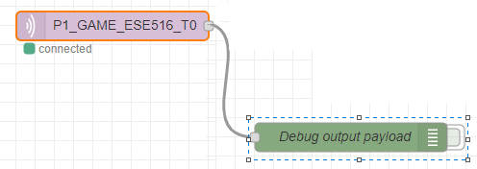
Node-Red – debug node
Click to clear output!
Debug NODE: Connected to this node is a DEBUG NODE. A debug node will print whatever it is connected to on the debug window. You can get to this window on the right screen of the backend view of Node Red (where you see the nodes). You can click on the green rectangle to activate/deactivate debug output.
Activated!
Click to activate

Slide 49
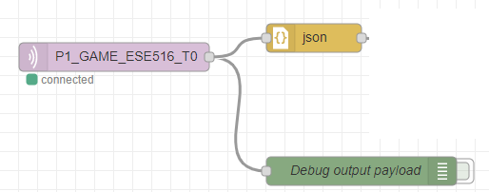
Node-Red JSON Block
The JSON block converts a JSON string into a Javascript Object. This will allow us to use Javascript on the data later on!

Slide 50

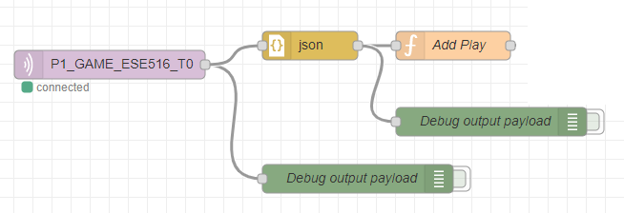
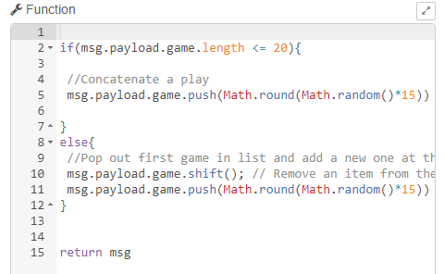
Node-Red Javacript Block (Function)
The function block can be added to run Javascript code! Double click on “Add Play” to see its code. In our example, this block is used to add a game play (random number between 0 to 15) to the end of the received play!
Function block

Slide 51
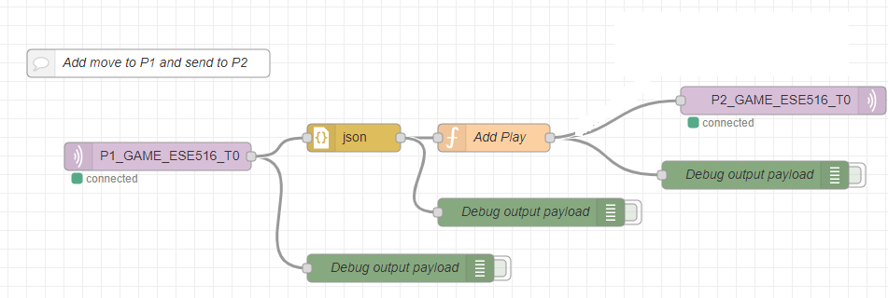
MQTT Out Block
MQTT Out button: Similar to the MQQT in, the MQTT Out will publish data to an MQTT Topic. In this case, we publist to the player 2 (P2_GAME_ESE516_T0).

Slide 52


Front end (ui) blocks
There are going to be special nodes (listed under DASHBOARD) that will allow us to develop a front end GUI. In this example, we use a text label that prints the output to P2.

Slide 53

Node-Red UI
When you double click a dashboard component you can modify how it will look! You can also assign to what group it will be added to (where it will be shown on the UI).

Slide 54


Node-Red UI
To configure the Layout of Dashboard block, you will need to configure the layout. To do so you can click on the topright layout button. On the layout tab you can add tabs and modify the position of existing DASHBOARD blocks into new groups.
Example of layout of our flow. For example the string we saw, P2 Move, is on the 2 PLAYER GAME SIMULATION Tab.

Slide 55

Node-Red- Deploy
Once you made changes and want to deploy your new code, hit the “Deploy” button on the top right. This will deploy your flow! It will mention any issues that might arise if they are present.

Slide 56

GOING TO THE UI
You can open the UI Website by clicking on the link in the Layout table.

Slide 57

NODE RED DASHBOARD
Website you can access from anywhere to see your dashboard
UI Organized by how you did it on the UI options

Slide 58

COOL! I want to learn more!
Node Red Cookbook: https://cookbook.nodered.org/
Node Red Tutorial: http://noderedguide.com/

